Slide 1

Online Delivery Restaurants

Slide 2

Spreadsheet Project:
Zomato Restaurants Analysis By Rohit Mehra

Slide 3

Agenda
Problem Statement
Data Description
Objective Key Metrics and Visualizations
Subjective Question for Insights

Slide 4
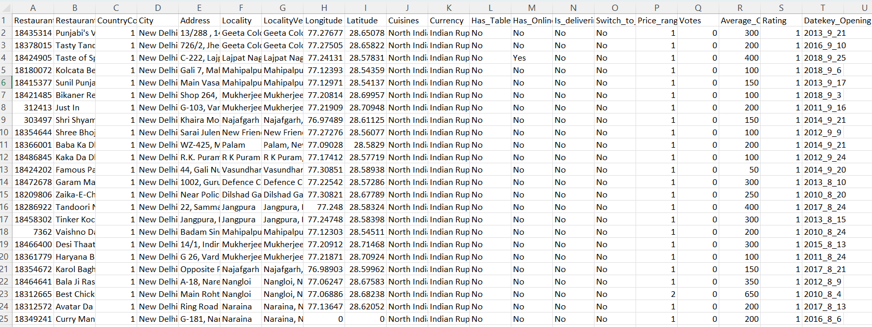
Problem Statement
You are hired as a consultant data analyst by zomato where the team is looking for expansion and opening restaurants. Your task is to come up with strategies/suggestions about opening newer restaurants.

Slide 5
The image above displays details about Zomato Sales Performance, including:
Restaurant ID: Unique identifier for each restaurant.
Restaurant Name: The name of the restaurant.
CountryCode: Country code of the location where the restaurant is situated.
City: The city where the restaurant is located.
Address: The specific address of the restaurant.
Locality: The locality or neighborhood where the restaurant is situated.
Locality Verbose: Detailed information about the locality.
Longitude: The geographical longitude coordinate of the restaurant.
Latitude: The geographical latitude coordinate of the restaurant.
Cuisines: The type of cuisine offered by the restaurant.
Currency: The currency used for transactions in the restaurant.
Has_Table_booking: Indicates whether the restaurant has a table booking option (Yes/No).
Has_Online_delivery: Indicates whether the restaurant offers online delivery (Yes/No).
Is_delivering_now: Indicates whether the restaurant is currently delivering (Yes/No).
Switch_to_order_menu: Indicates whether users can switch to the order menu (Yes/No).
Price_range: A numeric value indicating the price range category of the restaurant.
Votes: The number of votes or ratings/(feedback) received by the restaurant.
Average_Cost_for_two: The average cost for two people dining at the restaurant.
Rating: The overall rating of the restaurant is based on user reviews.
Datekey_opening: The date when the restaurant was opened.

Slide 6

Use this Link for copying and then manipulating the dataset.

Slide 7
Submission
There is a series of tasks/questions mentioned ahead in the Project, in order to guide the candidates to have suggestions, insights for the management.
Imagine you have to present the submitted PPT file to the senior management using which you are giving the suggestions as per the requirement with the reasoning/help of dashboard, visualizations or tables you’ve created.
The submission Zip file should consist of the following three documents:
Excel File (.xlsx) (consisting of dashboard)
Document File (.docx) (consisting of Answers and suggestions for Objective and subjective questions)
Presentation File (.pptx) (consisting of the presentation which you want to present to the management)

Slide 8

Tasks
…Tasks in order to come up with expansion suggestions

Slide 9
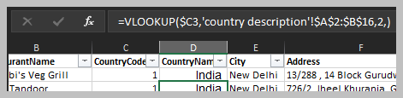
Objective Questions
The data consists of some inconsistent and missing values so ensure that the data used for further analysis is cleaned.
Approach :
Some columns aren’t formatted as required so we have formatted it and removed the missing values
Datekey_Opening column is not formatted as per date so we have extracted the year from this date column using function LEFT
Using the LookUp functions, fill up the countries in the original data using the country code.
Approach :
We have used the Vlookup formula
=VLOOKUP($C2,'country description'!$A$2:$B$16,2,)

Slide 10
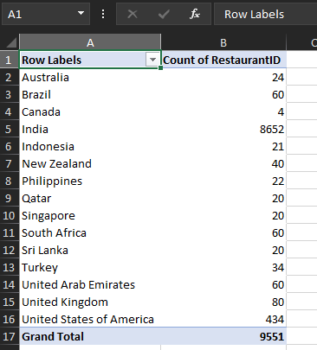
Objective Questions
Create a table to represent the number of restaurants opened in each country.
Approach:
We have created a PIVOT TABLE here and put the country name in rows field while the count of Restaurant IDs in values.

Slide 11
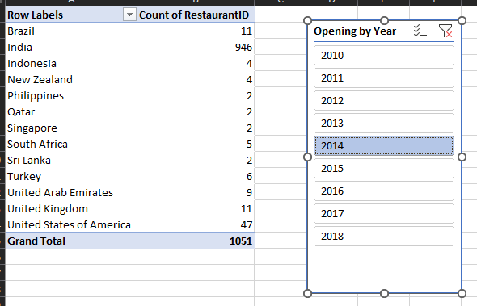
Objective Questions
Also the management wants to look at the number of restaurants opened in each year, so provide them with something here.
Approach :
We will be using a slicer here to filter the number of the restaurants with year.

Slide 12
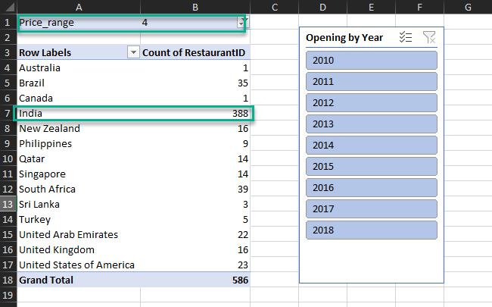
Objective Questions
What is the total number of restaurants in India which are in the price range 4?
It can be fetched e

Slide 13
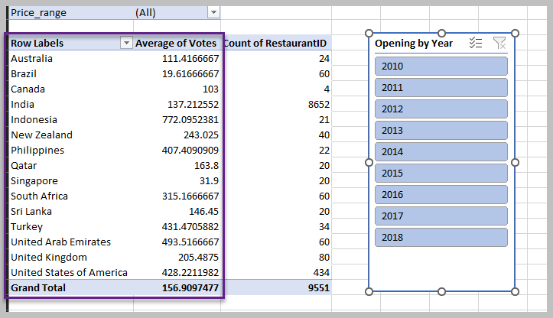
Objective Questions
What is the average number of voters for the restaurants in each country according to the data?
Approach:
We have used the votes column and aggregated it with average to find the answer to the above question.

Slide 14
In order to answer the next data analysis questions you will have to create Dashboards and visualizations (Can choose few pivot tables as well ).
For answering these questions you need to properly analyze the data through summarization, dashboard and visualizations to give the insights. Back your suggestions/insights with proper reasoning considering the data.

Slide 15
Data Analysis and Visualizations
Suggest few countries where the team can open newer restaurants with lesser competition. Which visualization/technique will you use here in order to justify the suggestions?
Approach :
In order to proceed with this problem, we have created 3 different pivot tables with respect to Country vs rating, Country vs Count of Restaurant and Country vs Average cost of Two.
As we can see in the provided data, we have different countries and similarly their currencies are also different, so we have to consolidate it one particular currency, so we have taken Indian currency into account and put the exchange rates of these currencies with respect to Indian currency.
Afterwards, we used the XLOOKUP formula to fetch the exchange rates in the raw data and multiplied it with the Average cost of two and created another column “Average Cost of Two in INR”.

Slide 16
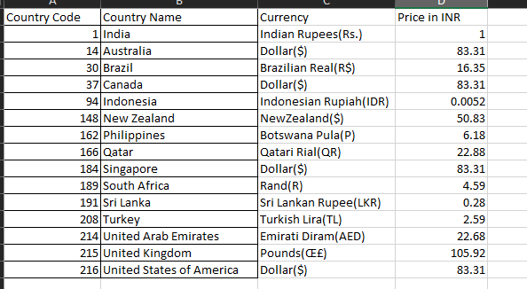
Data Analysis and Visualizations

Slide 17
Data Analysis and Visualizations

Slide 18
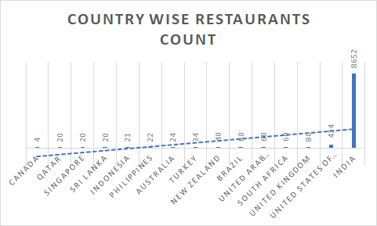
Data Analysis and Visualizations
From these three chart/visualizations we can identify the potentials countries where we can open new restaurants with lesser competition.

Slide 19
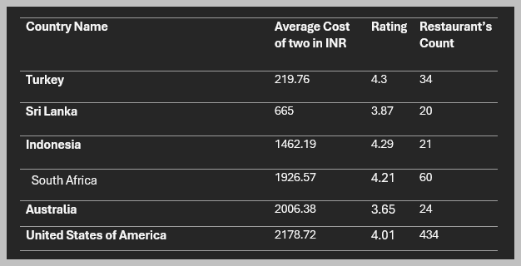
Data Analysis and Visualizations
Conclusion :

Slide 20
Data Analysis and Visualizations
Come up with the names of States and cities in the suggested countries suitable for opening restaurants.
Name the chart/spreadsheet function you will use for solving the problem?
According to the countries you suggested, what is current quality in terms of ratings for restaurants that are opened there?
Will you use any aggregation function or a visualization here to solve the problem?
Also what is the current expenditure on the food in the suggested countries, so that we can keep our financial expenditure in control? Mention the functionality which you will use for giving the suggestions, will it be any aggregated function or a visualization?

Slide 21
Data Analysis and Visualizations
Let’s break down these questions:
Suitable Locations for Opening Restaurants: When considering suitable locations for opening restaurants, it’s essential to research demographics, local cuisine preferences,ratings and economic factors(average cost) . As per our data ,
We have recommended : Turkey
Sri Lanka
Indonesia
South Africa
Australia
United States of America
Restaurant Quality Ratings: For restaurant quality ratings, the restaurants suggested by us are already having an average rating or more than 3.67. (On a scale of 5)
Food Expenditure: To control food expenditure, we have considered the share of consumer expenditure spent on food.

Slide 22
Data Analysis and Visualizations
In order to answer the above three questions, we have used the same pivot table and added the locality in the row in all those three pivots table and got the below data. Certainly, there can be more restaurants in the below countries but we have took 5-6 states in consideration.
The table has the data like in which state/City the team can open new restaurants in the given countries along with their ratings ,restaurants count and average cost for two in those states. Also we can include votes as well to further elaborate.
We have attached the table in the objectives document as the table is quite long because it contains the names of the states along with their average cost , rating , votes and restuarants count in table along with the city names .

Slide 23
Data Analysis and Visualizations
Come up with the names of restaurants from the recommended states who are our biggest competitors and also those which are rated in the lower brackets, i.e. 1-2 or 2-3.
How do you decide if anyone is a competitor?
If any restaurants has the average cost of two is less and is available in the areas where our newer restaurants will be , then we can say that it’s a competitor.
As the table is quite long, we have inserted it in the objectives document.

Slide 24
Data Analysis and Visualizations
Which cuisines should we focus in the newer restaurants to get better feedbacks? Does the choice of cuisines affect the restaurant ratings?
What is the basis for the suggestions? And mention how did you decide if the cuisines affect the ratings?
Approach :
In order to answer this question, we have created a pivot table and put the Country name and Cuisine names in row field and their respective rating in the values field and sorted the rating from highest to lowest.
In Newer restaurant we can focus on cuisines which are rated very high for example above 4.5 rating.
It’s further elaborated in the Objectives document as there are many visuals/Pivots .

Slide 25
Data Analysis and Visualizations
According to our current data, should we go for online delivery and table booking? Does that affect the customer’s ratings?
Mention your approach and spreadsheet function for the answer.
Approach :
In order to proceed with the above problem , we can created two pivot tables one for the online delivery and second for the table booking.
Row – Country name
Values – Ratings
Columns – Has_Online_Delivery

Slide 26
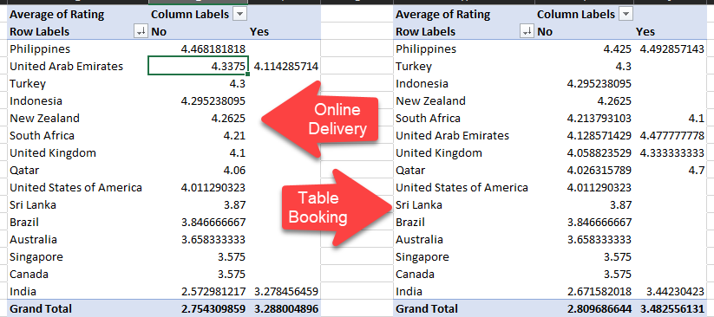
Data Analysis and Visualizations
As per the rating , we see the restaurants which have neither Online Bookings nor table bookings are having the ratings while those restaurants which are offering these aren’t rated as much as the one who aren’t offering these.

Slide 27
Data Analysis and Visualizations
Should the team keep the rate of cuisines higher? Will that affect the feedback? According to our data are the rate of cuisines and ratings, correlated?
Back the suggestion with proper insights and visualization.
Approach used:
Created a pivot table which has Country name and Cuisines in the Row field and Average cost of two by INR and average of rating in the values field.
Now we have calculated the correlation between the average cost of two by INR and rating column using the Correlation formula in excel and found that it’s 0.310387187.
Correlation measures the relationship between two variables. A correlation coefficient of 0 means that variables have no impact on one another — increases or decreases in one variable have no consistent effect on the other.
Here in our case it’s definitely not 0. So it’s clear that it has slight impact on the rating.
Conclusion:
We shouldn’t keep the price of the Cuisines higher as it will impact the feedback from the customer and yes the rates of the cuisines and the ratings are correlated and the correation coefficient is 0.31

Slide 28
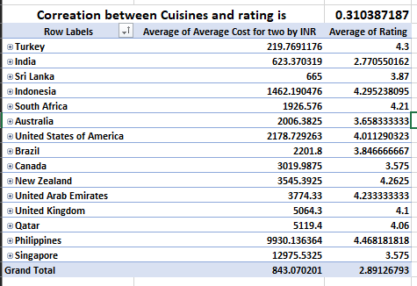

Slide 29
What is the distribution of number of restaurants of different price ranges in all the countries?
Distribution means the numbers of different price ranges, how will you show this using a chart?
Approach Used:
We can create a pivot tables and put the countries in Rows field and Price range in column field and count of restaurants ID in the values field so that we can have the desired result.
Now in order to show it on the chart we can use stack chart so that we can plot different price ranges on the columns

Slide 32
Ensure that you put the slicers for choosing the country and year in order to observe the dashboard since the management will be having a long discussion which can go for weeks.
Note: The dashboard would be more interactive and user-friendly, allowing management to explore data in detail and make informed decisions.

Slide 33
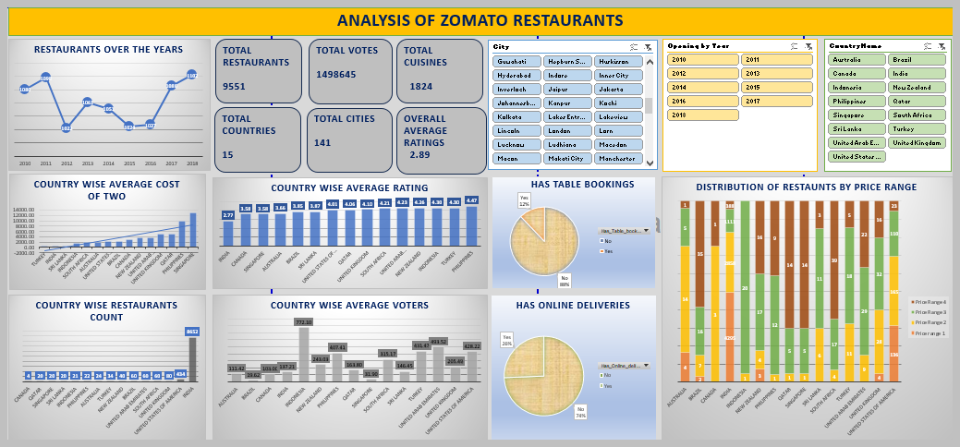
Dashboard :

Slide 34
SUBMISSION DEMONSTRATION
Refer to the video released in the batch

Slide 35
SUBMISSION FLOW
The candidates are supposed to have the first submission for the project within the 10-day deadline
After the submission, candidates will receive feedback on their project, which they are supposed to incorporate and re-submit within 1 week of feedback.
All the candidates are supposed to get a total of 8 marks to be prioritized in placements since is is necessary in Placements.
The re-submissions after 3 weeks of launch in the batch will be de-prioritised for evaluations.
Candidates will have to give the reason for their delay, in order to make sure that team picks up their evaluation.
This will create backlogs as the project for next module will also be releasing around the same time.
So make sure to submit the project (with the requirements) within timeline.

Slide 36
GUIDELINES:
Ensure to submit the project within the deadline.
TA support won’t be answering any direct questions regarding project.
Plagiarism will be checked during evaluation.
Queries regarding submission should be asked to success champions.
Candidates must score >=8 out of 10 in order to be picked for referrals.

Slide 37

EVALUATION
All the components mentioned below hold significance while evaluation:
Excel File: (45% marks)
Data Cleaning
Dashboarding
Proper formatting
Correct choice of visualization charts
Doc File: (45% marks)
Exact answers to the objective questions
Proper answers to the subjective questions with reasoning
Proper formatting
Presentation File: (10% marks)
Proper storytelling
Proper formatting

Slide 38


